Slide 1
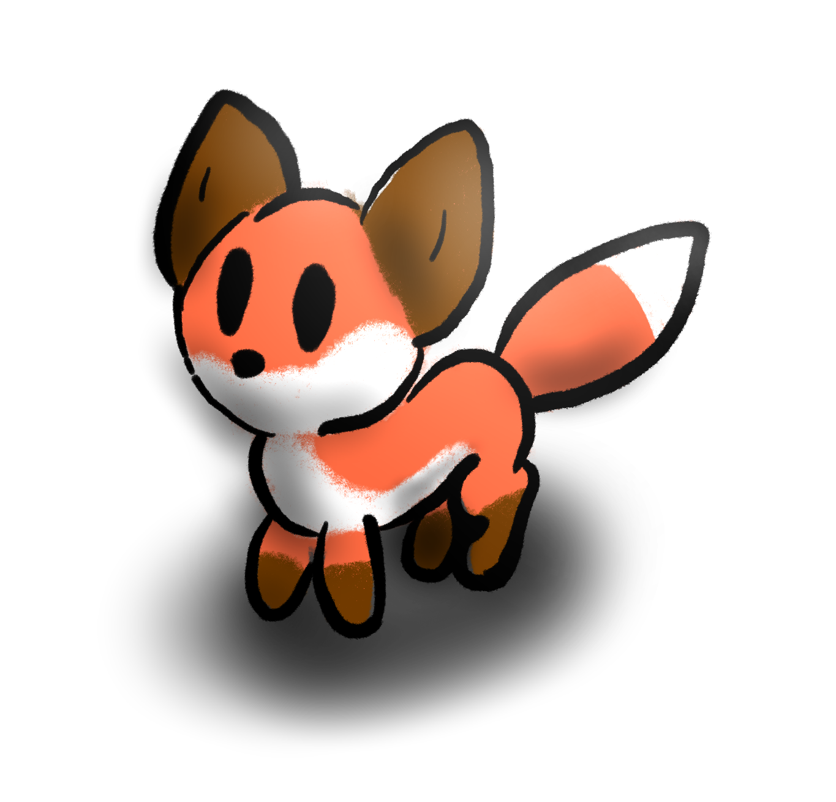
VR Pets
Third Update

Slide 2
Last Time…
Still Deciding on Hardware (Kyle?)
No Environment (Kyle)
No Interactivity (Josh)
Default Model/Animations (Elliot)
No Interface (Kurt)

Slide 3
VR or AR?
Over Winter Break, we decided.
VR
Equipment available to us
Easier Implementation
More Users

Slide 4
Well…
What are we using?
Oculus Rift
Oculus Touch
Unity 2018.3.1f1
Blender

Slide 5
Section Formats:
What was done?
What got done over break?
Milestones?
What do we do next?

Slide 6
Environment:
Before Break, we had basic Unity project.
We created the environment.
See next slide

Slide 7
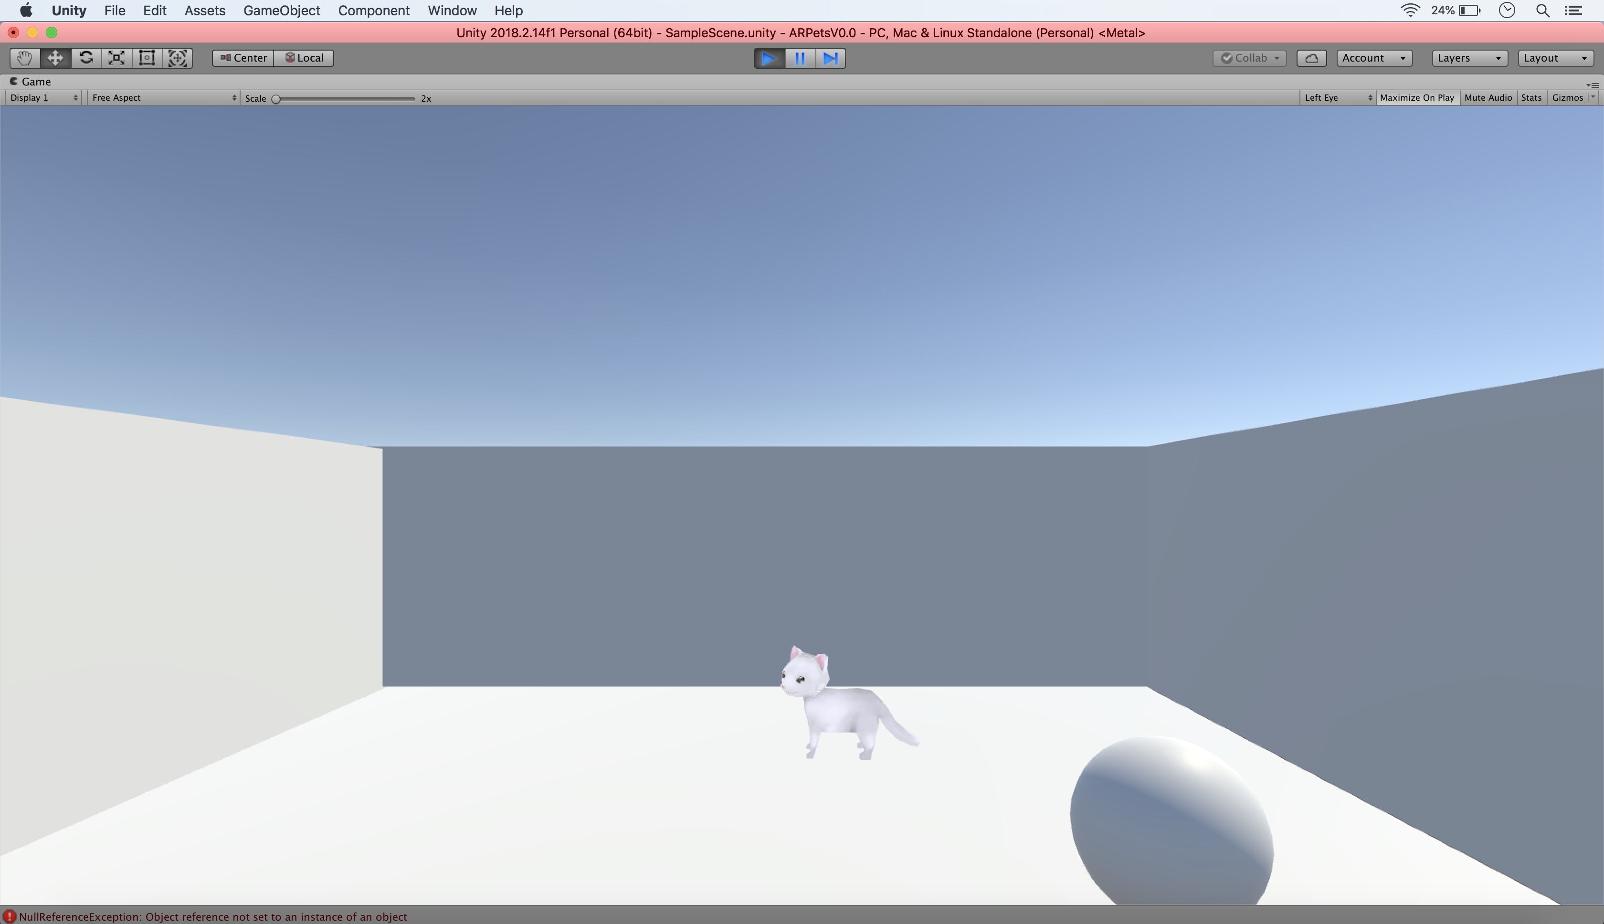
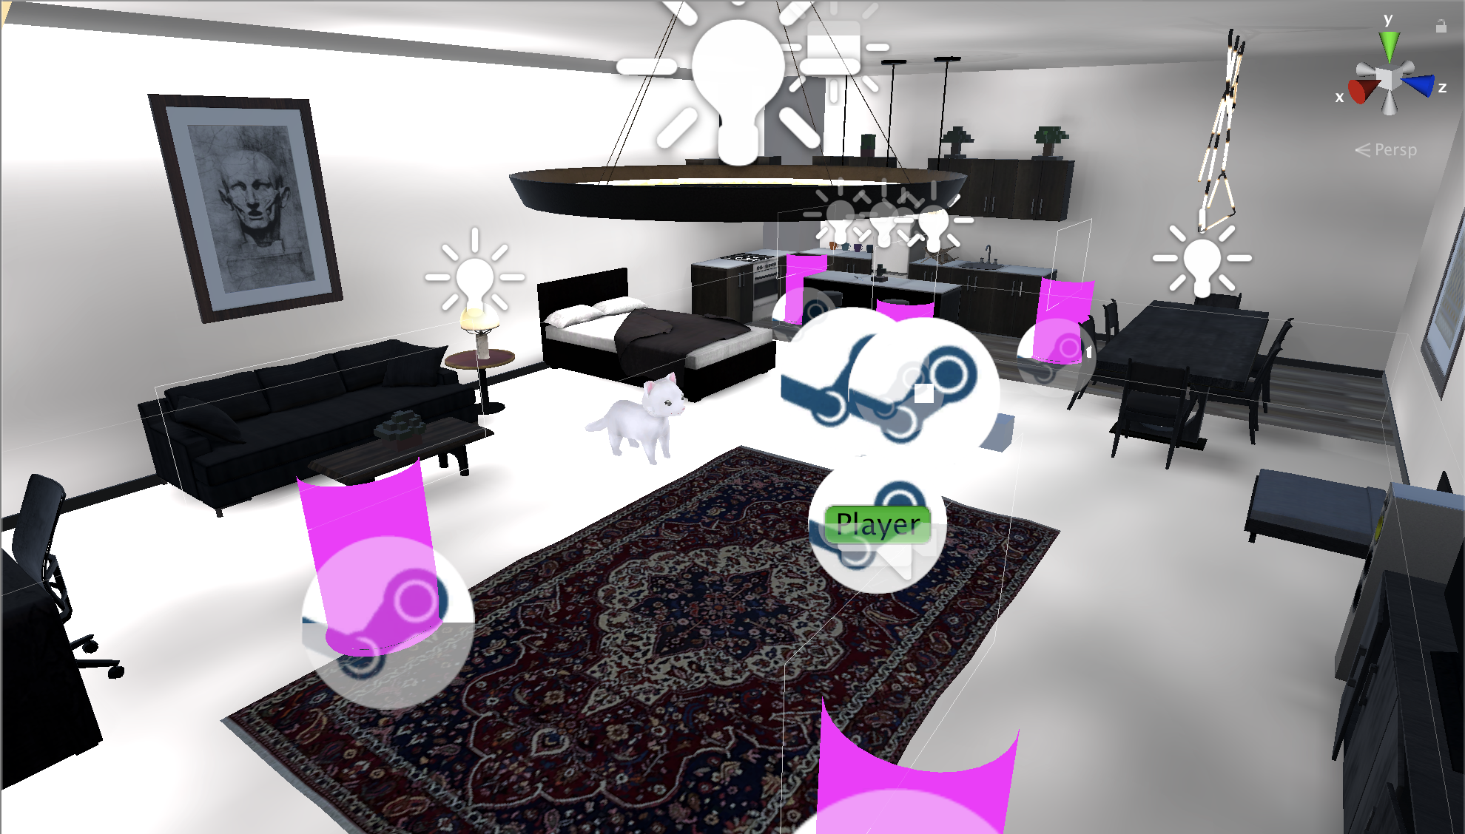
<- From This…
To this! ->

Slide 8
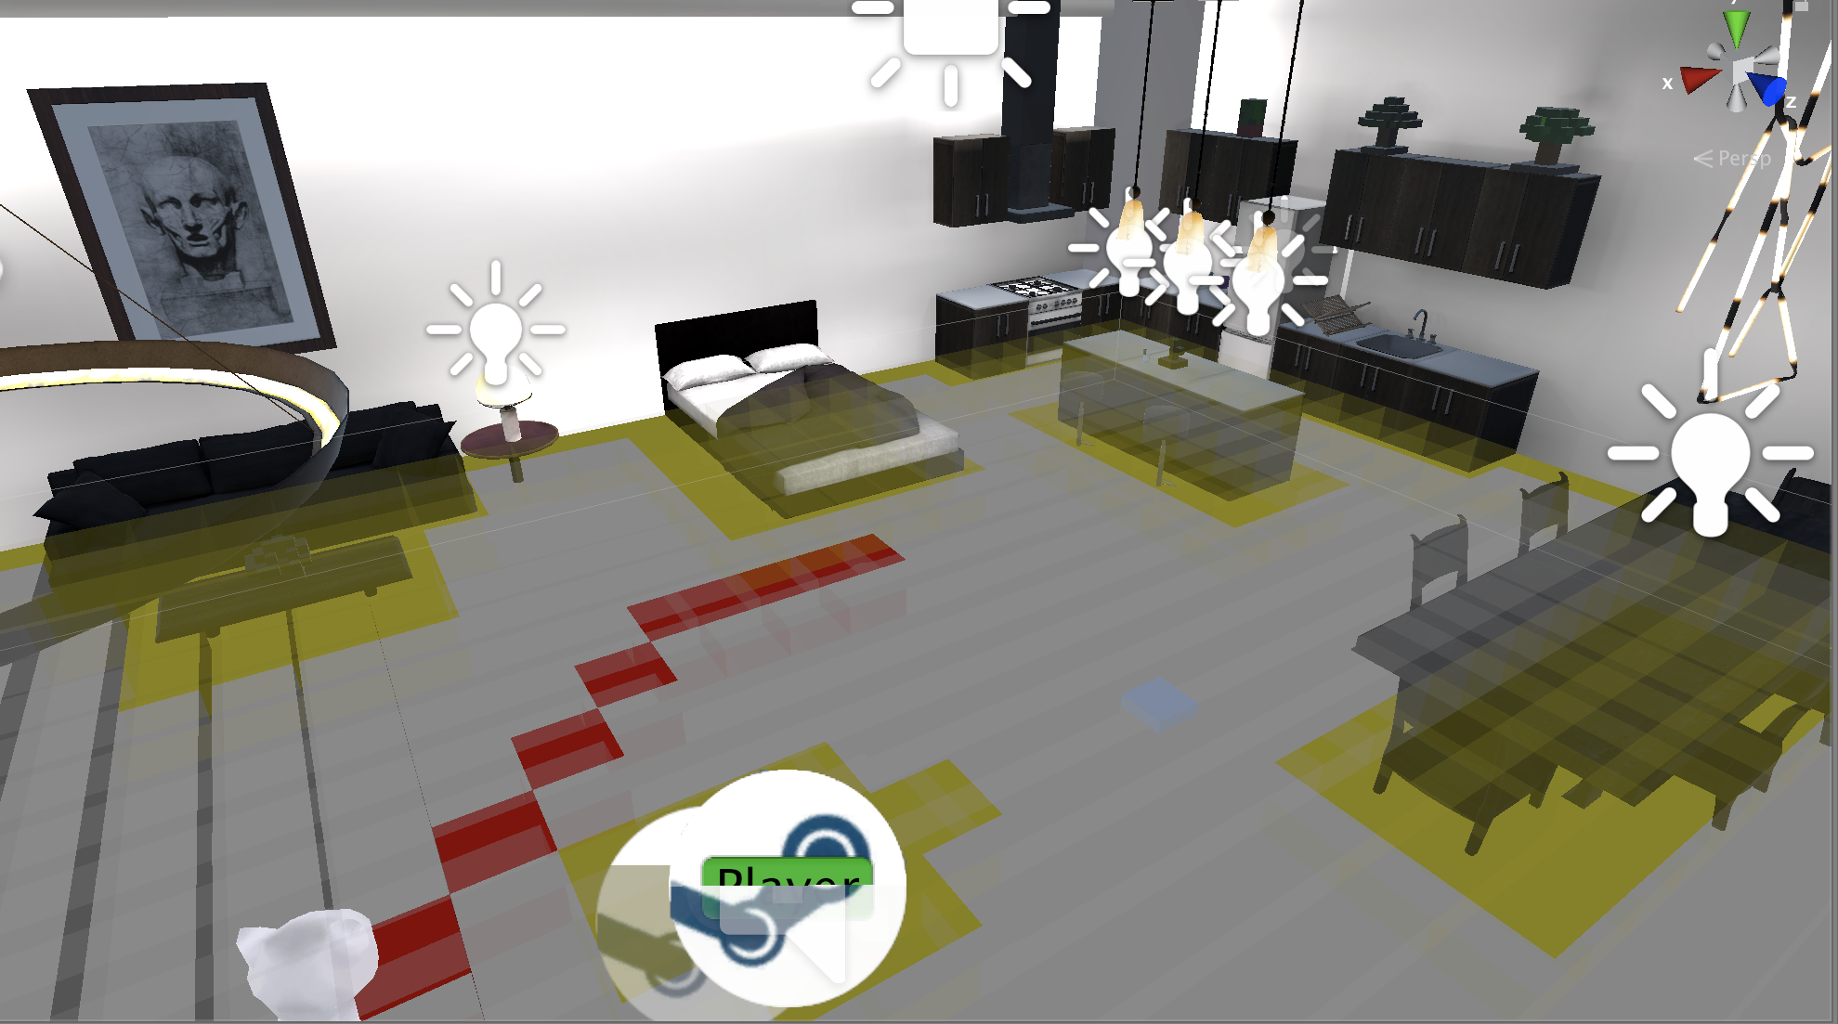
Interactivity
A* Pathfinder
Dummy Walk AI

Slide 9
Interactivity
Throw a ball/Fetch

Slide 10
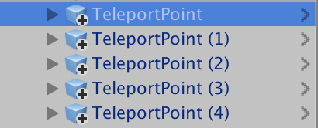
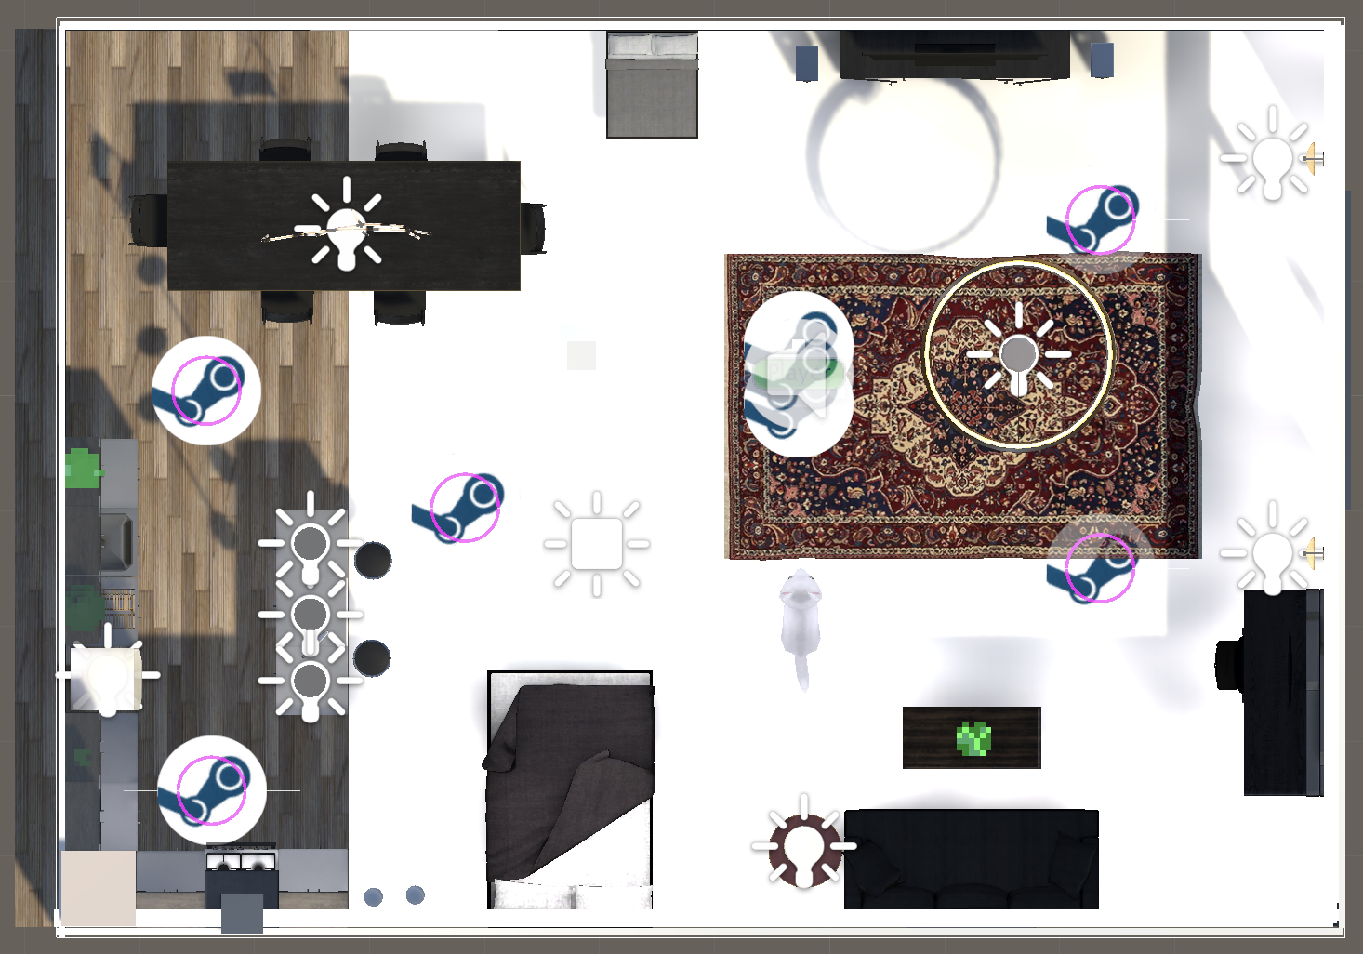
Interactivity
Raycast to Teleport
Specific locations

Slide 11
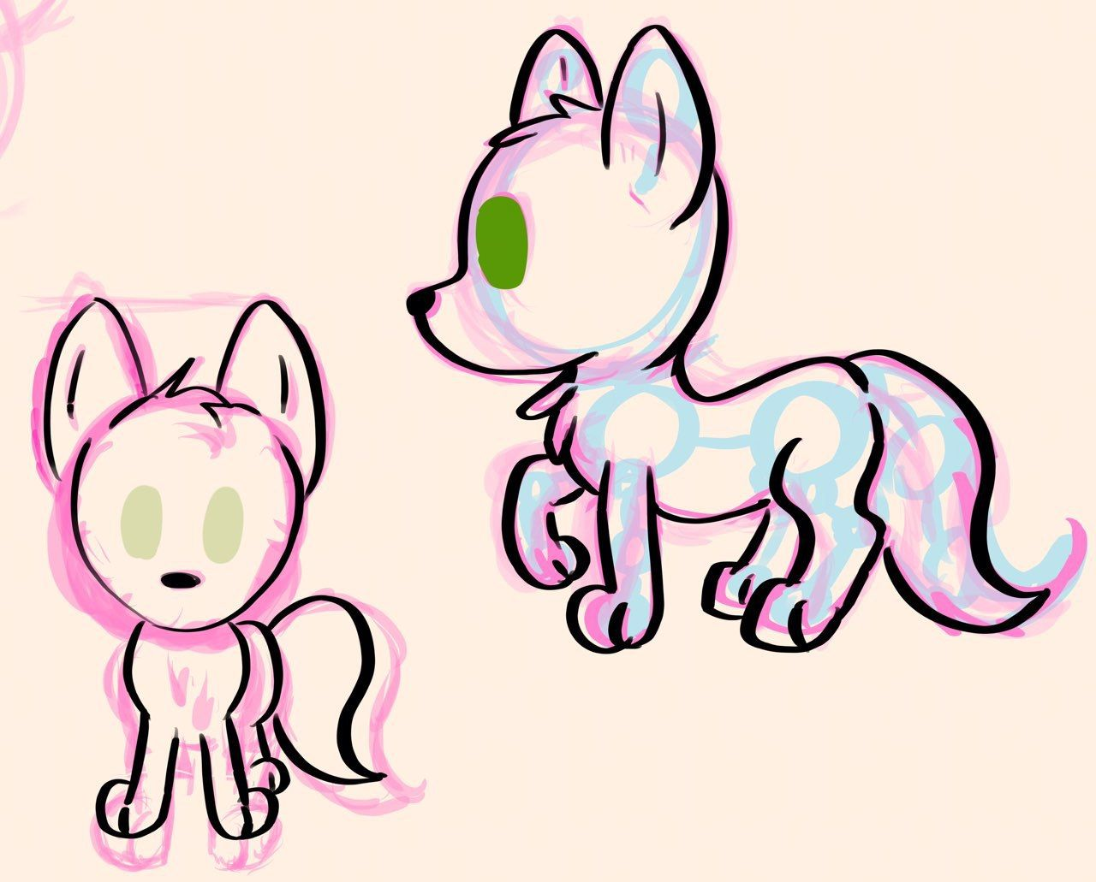
Model Work
Sketch, Modeling/Rigging in Blender
+
+
Started With Just Sketches and our default Cat Lite…
Off to Blender!
->

Slide 12
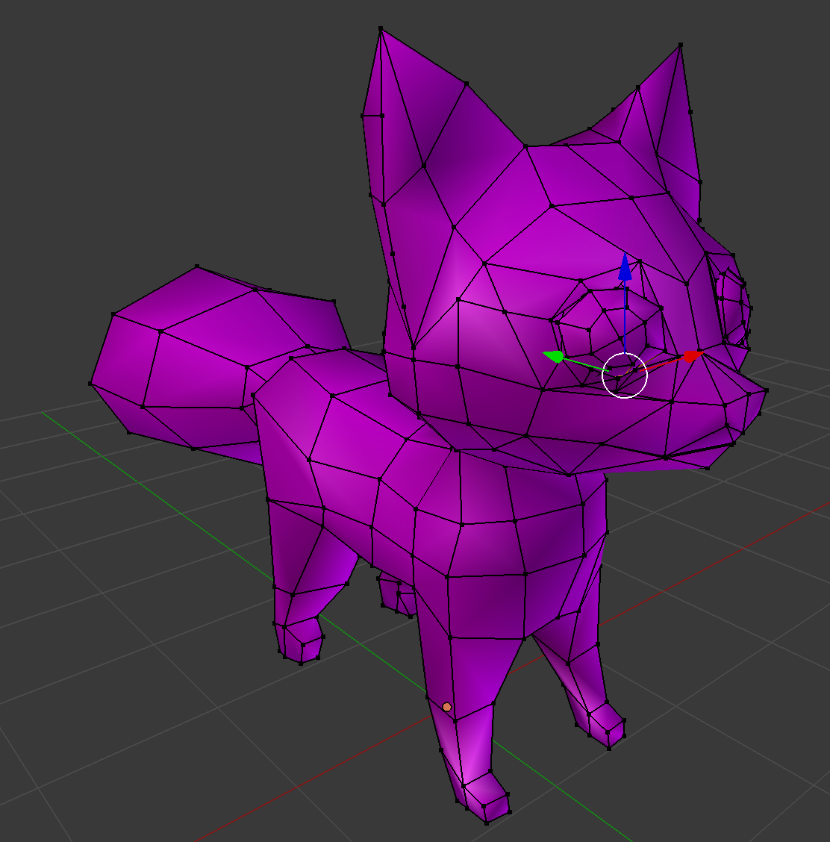
Basing everything on default cat:
Got to this:
What about color?
->

Slide 13
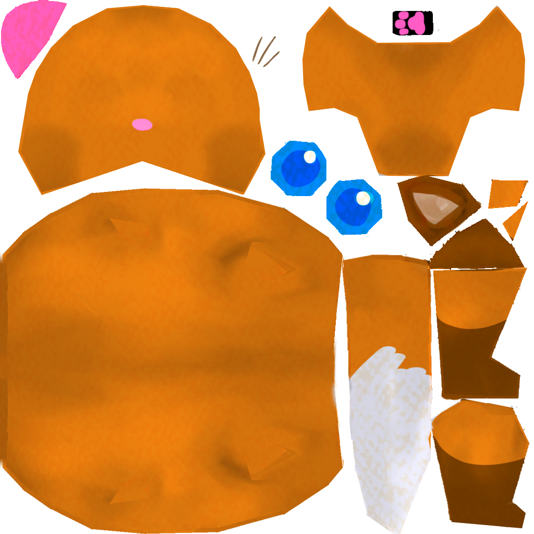
From doodle plus model…
Made a texture based on Cat Lite’s.
Applied it and…..???
+
???
+
->

Slide 14
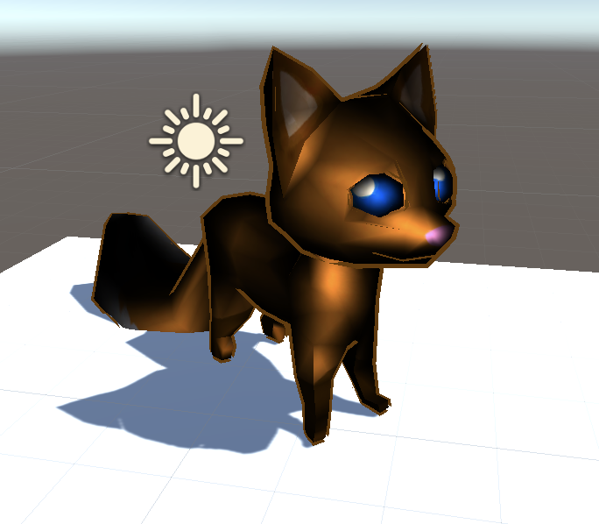
From doodle plus model…
Made a texture based on Cat Lite’s.
Applied it and…..???
+
+
->

Slide 15
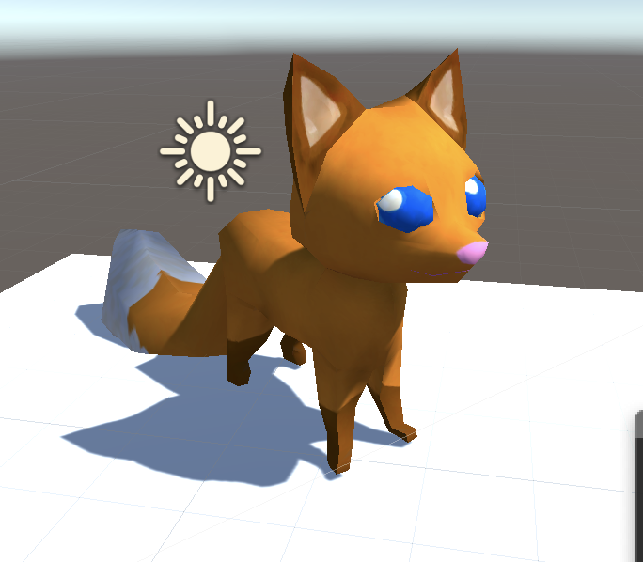
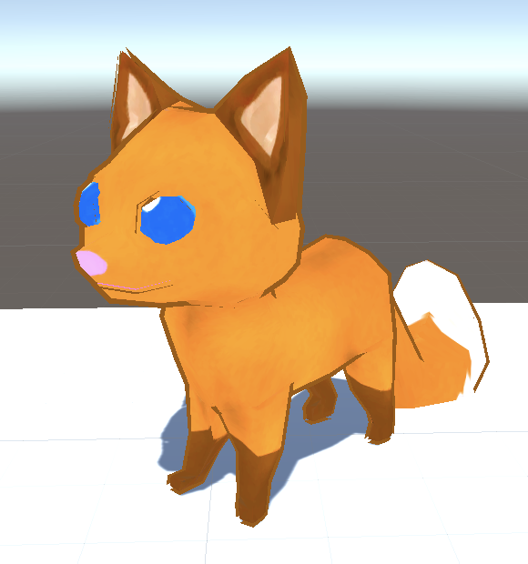
So I fixed the shader…
Decided to go with a toon shader.
->

Slide 16
As for animations…
The cat lite Default animations:
Loaded onto Fox Model
(With difficulty)
->

Slide 17
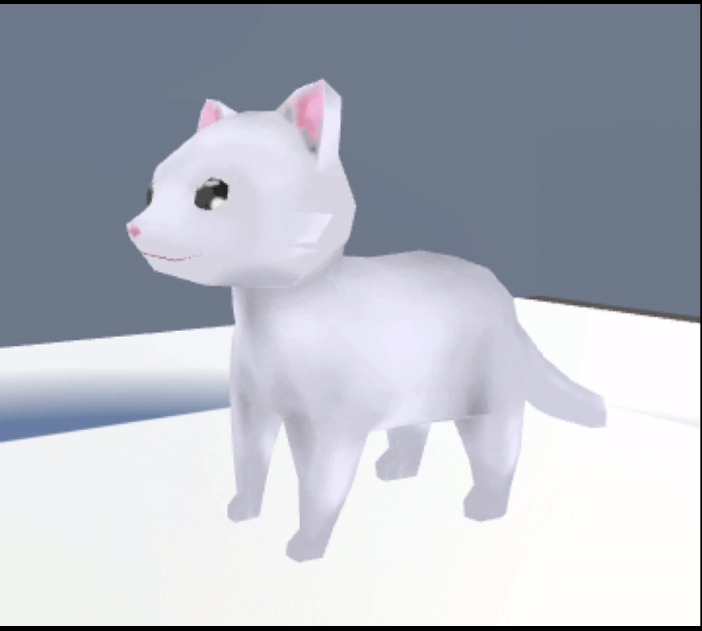
As for animations…
The cat lite Default animations:
Loaded onto Fox Model
(With difficulty)
->

Slide 18
Next?
Fix/More Animations
Load Model into Main Project
Trigger Animations with Events
At the end…
Tweak/Refine

Slide 19
Interface
What was done?
What got done over break?
Milestones?
What do we do next?

Slide 20
Thank you!

